Slide 1


Epidemiology & NVBDCP
India’s path to Elimination by 2027
Dr. Mukul Maheshwari

Slide 2
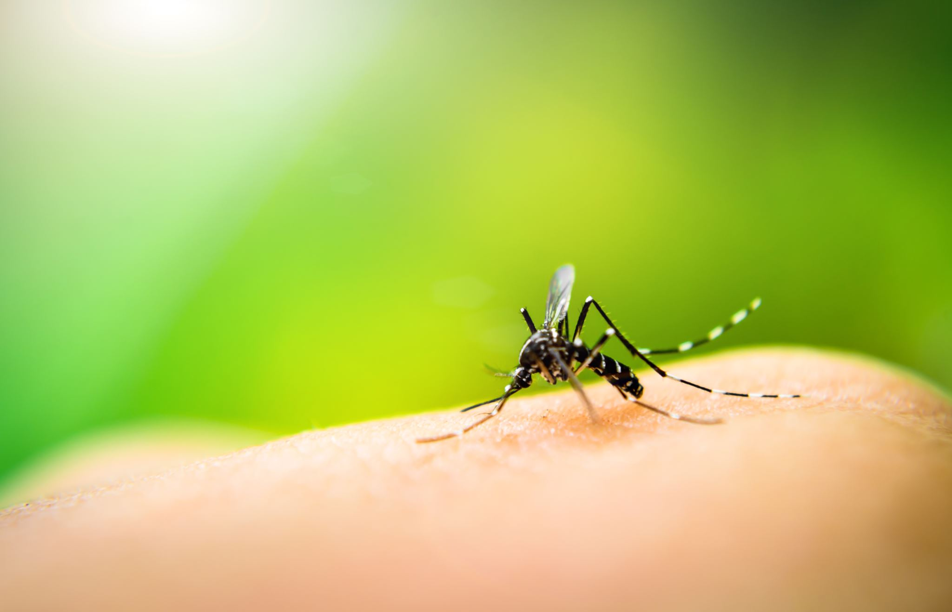
Driven to End Malaria: Now We Can. Now We Must

Slide 3
Learning Objectives
Describe
Current malaria epidemiology in India.
Explain
Structure of the national malaria programme.
Goals
India’s major malaria elimination goals & targets.
Discuss
Surveillance As the core intervention for elimination.
Outline
Key entomological principles And vector control strategies.
Identify
Major challenges in the last mile toward elimination.

Slide 4
Reasons for this discussion
India has shown a major decline in malaria over the last decade, but transmission has become increasingly local, focal, and difficult to eliminate.
The present challenge is not only treatment of malaria cases, but finding every case, classifying every focus, and preventing onward transmission.
Elimination is now a programme-driven public health task rather than a purely clinical task.

Slide 5
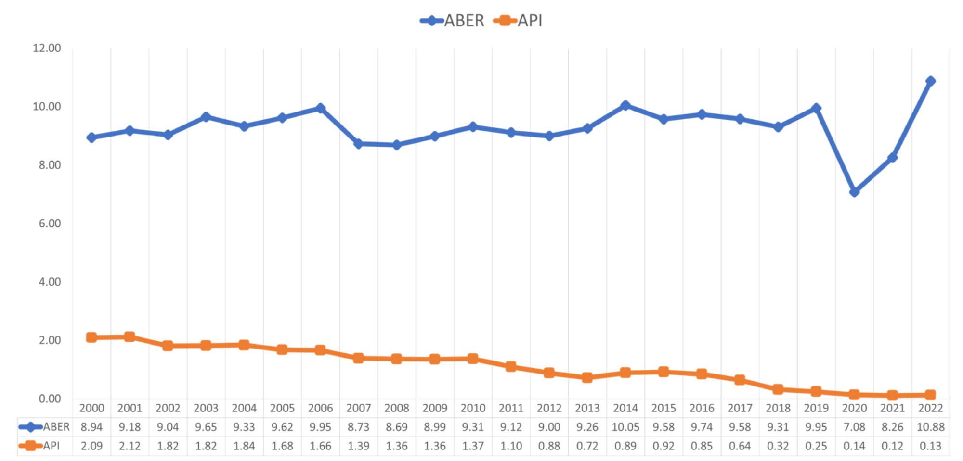
India contributed 65.7% of the estimated malaria cases in the WHO South-East Asia Region in 2022.
India achieved about 85% decline in malaria cases and 78.3% decline in deaths in 2022 compared with 2015.

Slide 6
API in India declined from 2.09 in 2000 to 0.13 in 2022. Malaria deaths declined from 932 in 2000 to 83 in 2022. Reported P. falciparum cases declined from 11,36,423 in 1995 to 98,306 in 2022.
Transmission in india is increasingly concentrated in hilly, forested, forest-fringe, border, tribal, project,and migrant settings.
High-risk groups include tribal populations, mobileand migrant groups, forest workers/goers, shifting cultivators,and socioeconomically disadvantaged populations.
Urban malaria remainsa separate operational challenge.

Slide 7
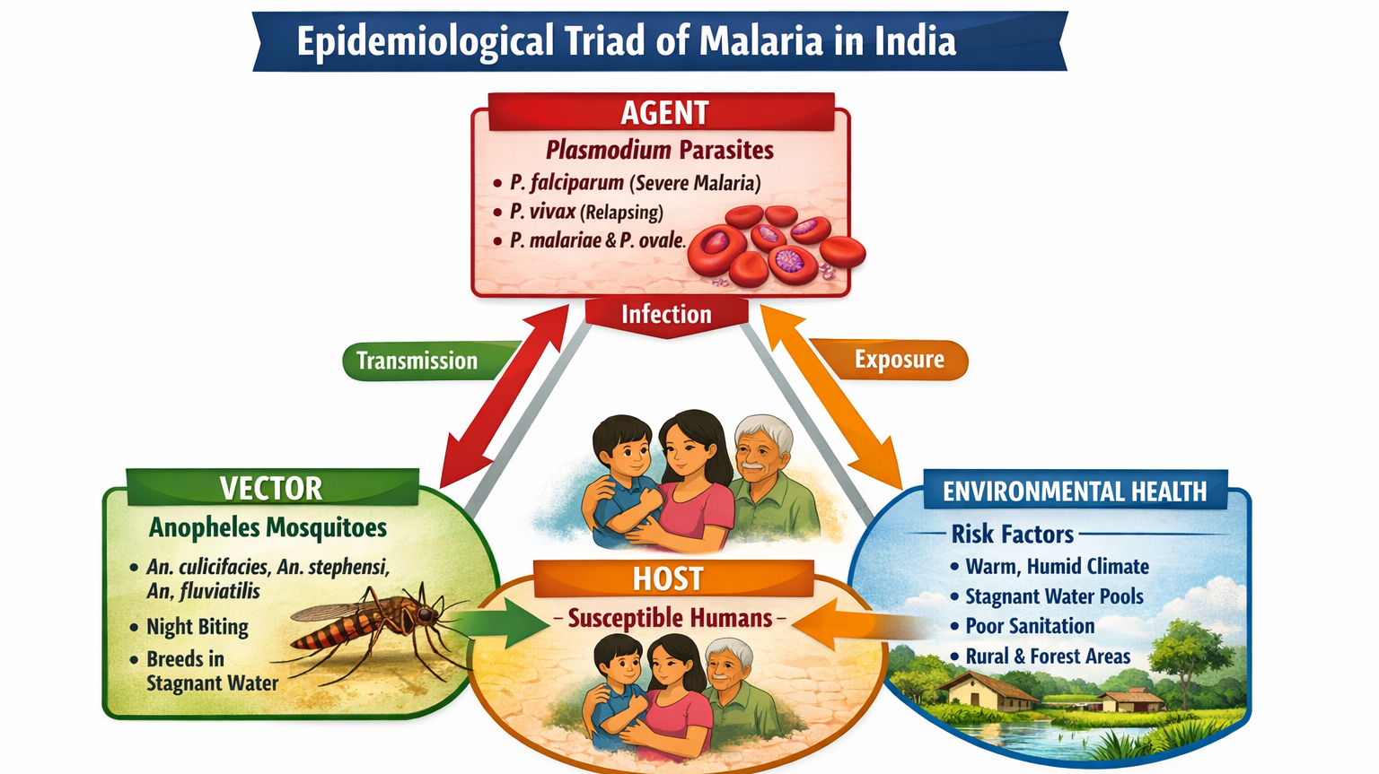

Slide 8
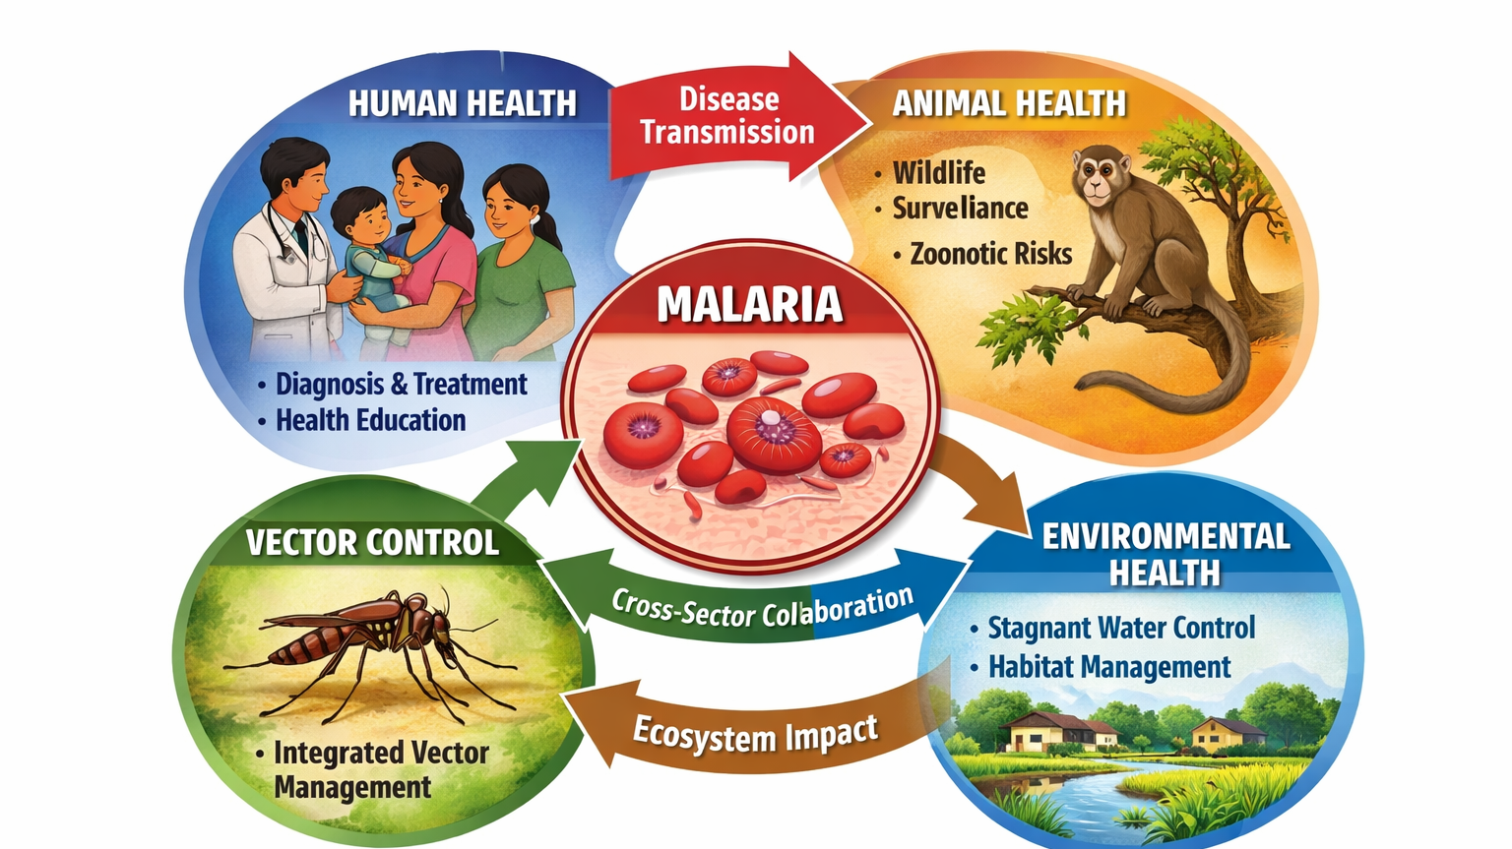

Slide 9

Vector: Mosquito; Family -Anopheles

Slide 10
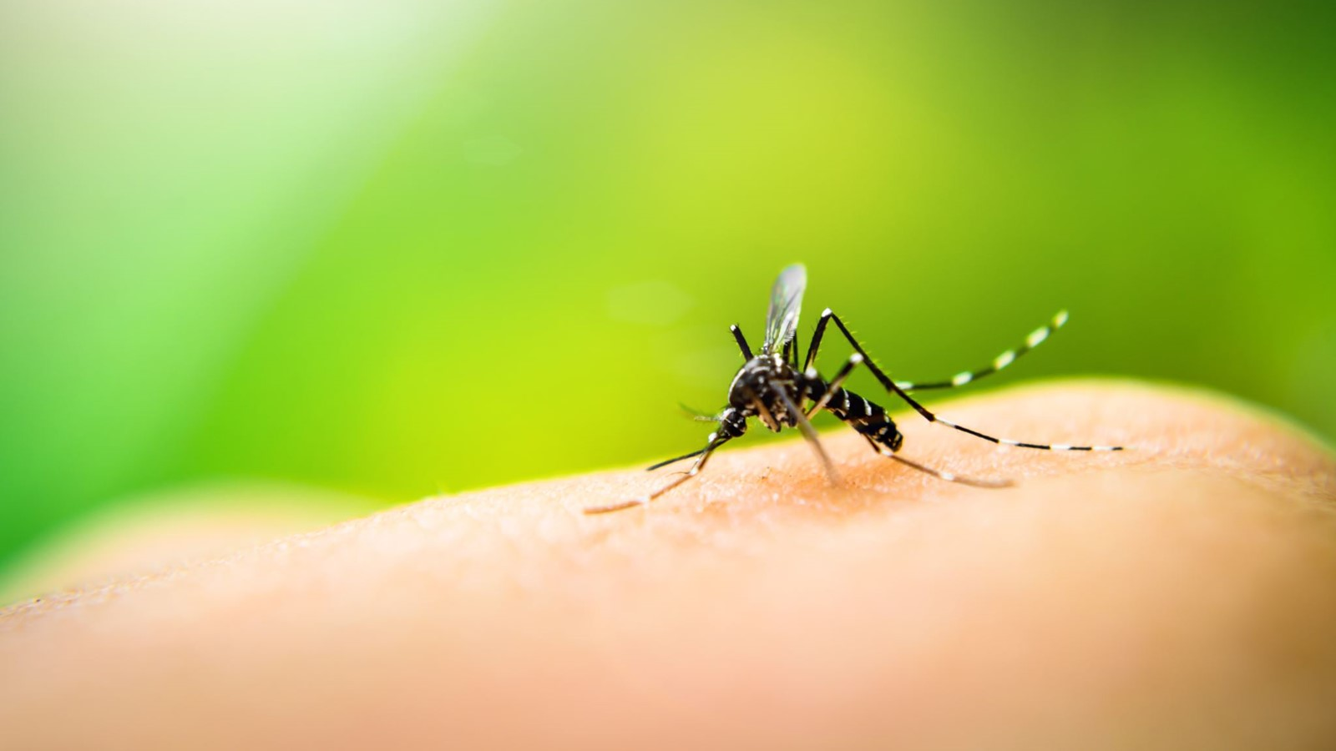
Anopheles – Mosquito (9/58)
Primary vectors mentioned in the NSP:
Anopheles culicifacies (rural, major)
Anopheles fluviatilis (hilly & forest)
Anopheles minimus (NE)
Anopheles baimaii (dirus) (NE – forest)
Anopheles stephensi (urban)
Anopheles epiroticus (sundaicus) (coastal)
Secondary vectors of local importance:
AnophelesAnnularis
Anopheles philippinensis
Anopheles varuna

Slide 11
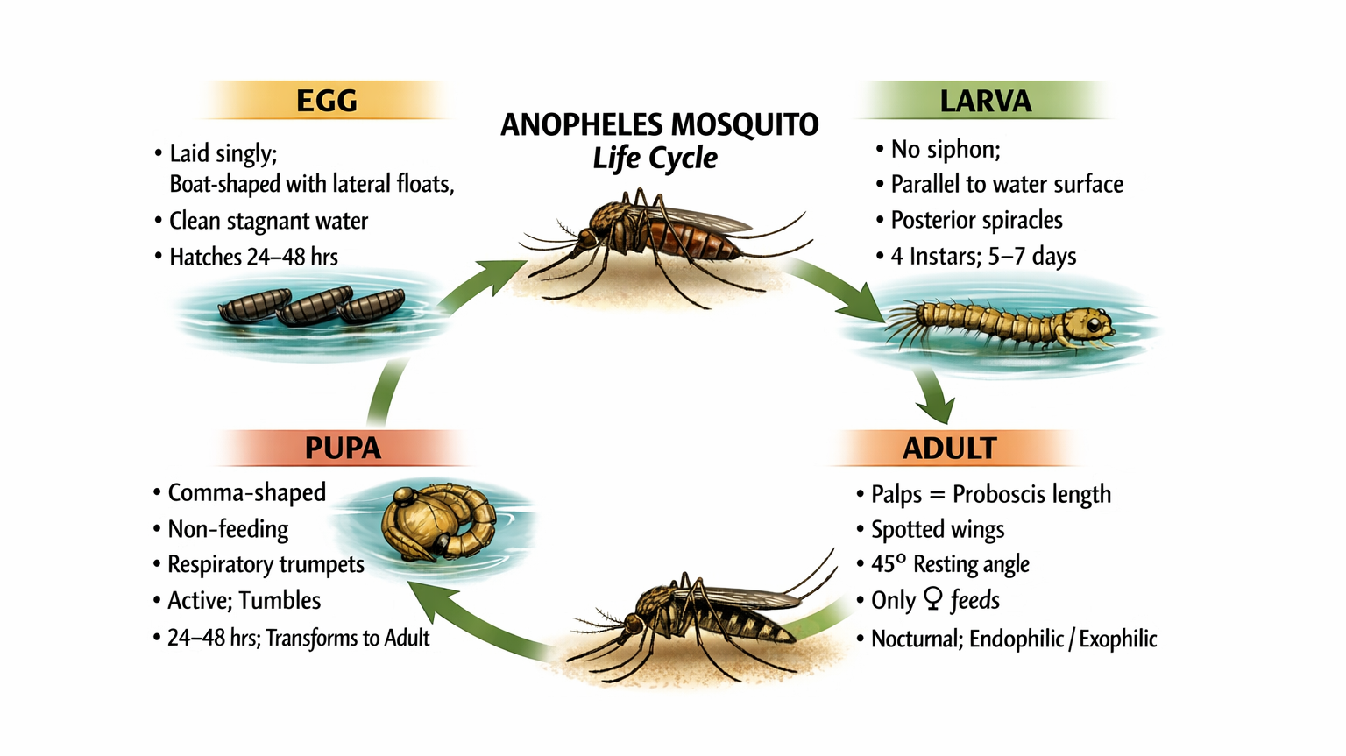

Slide 12
Agent - Plasmodium
Species | Significance
P. falciparum | Severe/cerebral malaria; drug resistance risk; no dormant stage
P. vivax | Hypnozoites cause relapse; radical cure with primaquine required
P. malariae | Quartan fever; nephropathy in chronic infection
P. ovale | Rare in India; relapse like vivax
Four species cause malaria: P. falciparum, P. vivax, P. malariae, P. ovale23-27.pdf
In India, P. falciparum and P. vivax are the two major species.pdf

Slide 13
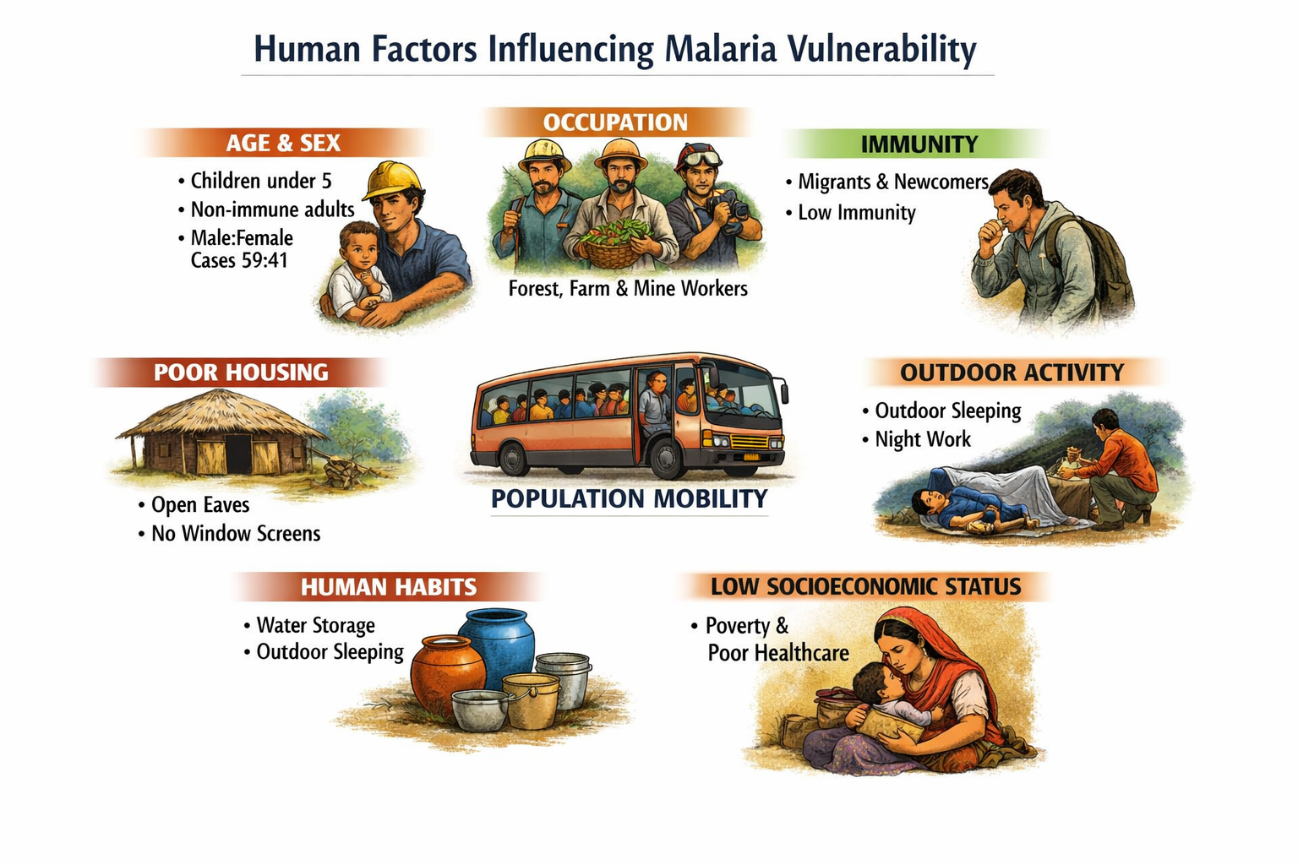

Slide 14
Environment
Climate:
Optimum temperature: 20–30°C for parasite development in the mosquito
Relative humidity: at least 60% required
Rainfall provides mosquito breeding opportunities
Seasonality:
Peak incidence: July to November in most parts of India
Varies by altitude, geography and local ecological conditions
Sustaining transmission:
Forests and forest fringes
Hills and valleys
River basins and irrigation canal areas
Urban water storage and construction sites (An. stephensi)
Border areas and project sites

Slide 16
Indicators
Indicator | Full form | What it measures
API | Annual Parasite Incidence | New confirmed cases per 1,000 population per year
ABER | Annual Blood Examination Rate | Blood slides examined per 100 population per year
SPR | Slide Positivity Rate | % of blood slides tested that are positive for malaria
SFR | Slide Falciparum Rate | % of slides positive specifically for P. falciparum
AFI | Annual Falciparum Incidence | Falciparum cases per 1,000 population per year
TPR | Test Positivity Rate | % of all tests (RDT + microscopy) that are positive

Slide 17
Indicators
Annual Parasite Incidence (API):
(Confirmed malaria cases ÷ Population under surveillance) × 1,000
Used for district categorization (Category 0 to 3)
Also used for resource allocation and intervention prioritization
Annual Blood Examination Rate (ABER):
(Blood slides examined ÷ Population) × 100
Target: ≥10% of population should be tested annually
Measures surveillance intensity, low ABER means cases are being missed
A programme with low ABER and low API may be underreporting, not truly eliminating
Slide Positivity Rate (SPR):
(Positive slides ÷ Total slides examined) × 100
Reflects transmission intensity in the area
High SPR despite high ABER = genuine high burden
Used to monitor trends even when population data is unreliable
Slide Falciparum Rate (SFR):
Proportion of slides positive specifically for P. falciparum
Important because falciparum carries higher mortality risk and resistance implications
High SFR areas need intensified treatment and drug resistance monitoring
Annual Falciparum Incidence (AFI):
Falciparum-specific version of API
Critical for tracking severe malaria risk and guiding treatment policy

Slide 18
Elimination Indicator
Category | Definition | Action phase
Category 0 | Zero indigenous cases | Prevention of re-establishment
Category 1 | API < 1 per 1,000 | Elimination phase
Category 2 | API 1 to <2 per 1,000 | Pre-elimination phase
Category 3 | API ≥ 2 per 1,000 | Intensified control phase
Category | 2015 | 2022
Category 0 | 30 districts | 128 districts
Category 1 | 494 districts | 603 districts
Category 3 | 109 districts | 18 districts

Slide 19
Programme Indicators
Output indicators (programme):
Number of blood slides examined (ABER)
IRS coverage achieved
LLINs distributed and in use
Number of cases notified and investigated
Number of foci investigated and responded to
Outcome indicators (short-term results):
SPR / TPR trends
Proportion of cases receiving parasitological confirmation
Proportion of confirmed cases receiving treatment within 24 hours
Impact indicators (long-term change):
API trend
Malaria mortality rate
Number of Category 0 districts
Number of states and UTs achieving zero indigenous cases

Slide 20
Regular monitoring of:
Vector species composition
Vector density
Breeding habitats
Resting and biting behaviour
Foci characteristics
Insecticide resistance patterns
Programme use:
Guides selection of vector control tool (IRS vs LLINs vs larval control)
Monitors effectiveness of ongoing interventions
Detects emerging resistance for early insecticide rotation
Informs spatial targeting of interventions at foci and district level
Entomological Surveillance: Components

Slide 21
Evolution of the programme
1953: National Malaria Control Programme (NMCP)
1958: National Malaria Eradication Programme (NMEP)
1977: Modified Plan of Operations after malaria resurgence
2003: Integration into NVBDCP under the vector-borne disease umbrella
2016: National Framework for Malaria Elimination (NFME) 2016-2030 launched
2023: National Strategic Plan (NSP) 2023-27 - current framework
Current programme leadership is through NCVBDC under MoHFW/NHM

Slide 22
Control to elimination
Control Era
Elimination Era
Reduce morbidity and mortality
Aggregate case statistics
Routine passive surveillance
Standardized vector control
Zero indigenous cases; interrupt transmission
Case-based individual investigation
Active, reactive and proactive surveillance
Evidence-based, targeted vector control

Slide 23
Vision, mission and goals
Vision: A Malaria Free India
Mission: Malaria elimination in India by 2030 aligned with GTS and NFME 2016–30
Operational goal: Achieve zero indigenous malaria cases by 2027 and create an enabling environment to prevent re-establishment.

Slide 24
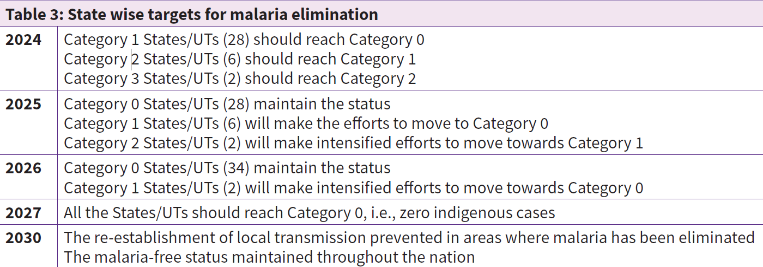
Targets

Slide 25
Strategy
The five strategic approaches are:
Transform malaria surveillance as a core intervention.
Ensure universal access to diagnosis and treatment: testing, treating and tracking.
Ensure universal access to prevention through optimized vector control.
Accelerate efforts toward elimination and malaria-free status.
Promote research and innovation for elimination and prevention of re-establishment.

Slide 26
Malaria Surveillance
Surveillance is no longer a supportive activity; it is the central strategy of elimination.
Near-real-time reporting through IHIP-malaria is being rolled out.
Case-based, foci-based, and entomological surveillance are all to be strengthened.
Programme surveillance includes:
Detection of every malaria case
Notification and classification of cases
Case investigation
Foci investigation and response
Active and reactive case detection
Complete reporting from public and private sectors
Real-time dashboards and review for action

Slide 28
Malaria specific case definitions
Suspected Case
Any case of fever
Reported at community level by ASHAs, AWWs, field workers — no clinical examination required.
Simply having fever qualifies as a malaria suspect in an endemic area.
Probable Case
A case that meets the clinical case definition of malaria
Clinical case description of malaria:
Fever (acute, with or without chills and rigors)
Headache, bodyache, nausea/vomiting
Splenomegaly in residents of endemic areas
History of living in or travel to an endemic area
Diagnosed by a Medical Officer on clinical grounds
Confirmed Case
A suspected or probable case that is laboratory confirmed by either:idsp.mohfw
Demonstration of malaria parasite in blood film (microscopy), OR
Positive Rapid Diagnostic Test (RDT) for malaria

Slide 29
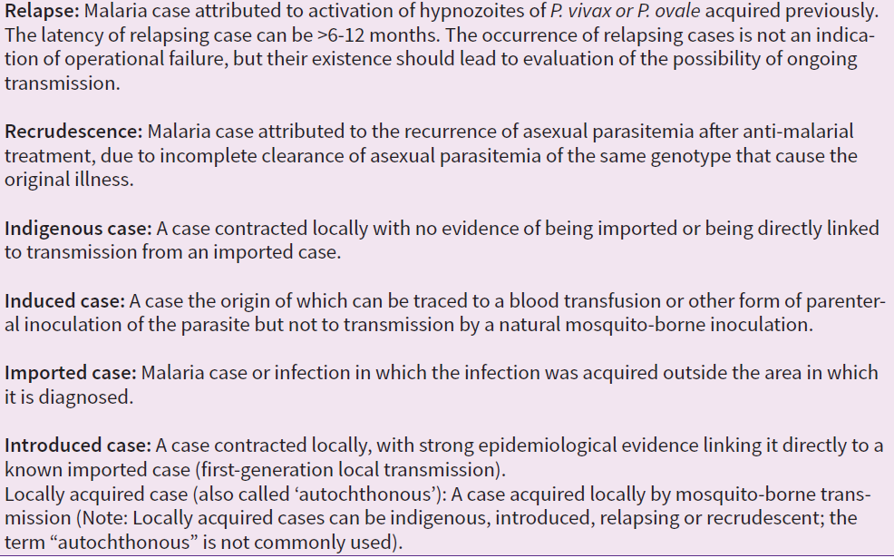
Operational definitions

Slide 30
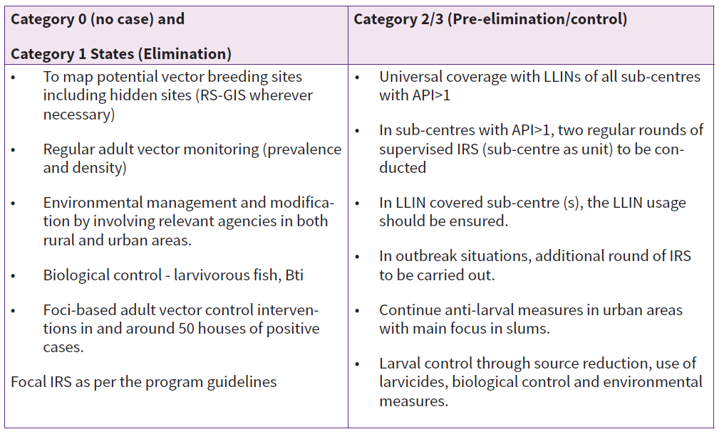

Slide 31
Universal access
Every suspected case should have parasitological confirmation.
Quality-assured RDTs and microscopy should be available across levels.
The programme emphasizes testing, treating and tracking.
Follow-up of relapse, recrudescence and treatment failure is important.

Slide 32
Universal access - prevention
Entomological surveillance
Foci investigation
Insecticide resistance monitoring
IRS
LLINs
Larval source management
Emergency vector control when indicated

Slide 33
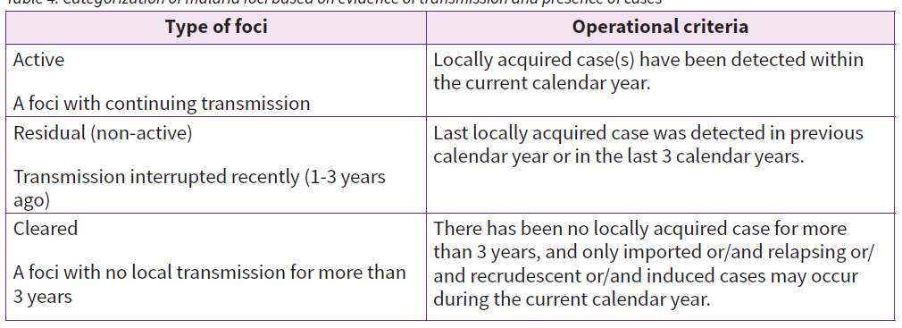
Foci

Slide 34
Integrated Vector Management
Integrated Vector Management (IVM) means using multiple evidence-based vector control tools according to local ecology and programme data rather than using one method everywhere.
Possible components include:
IRS
LLINs / ITNs
Larval source management
Biological methods such as larvivorous fish
Environmental management and source reduction
Personal protection measures

Slide 35
IRS and LLINs
IRS
IRS remains a core intervention in appropriate areas.
It must be based on vector behaviour, susceptibility pattern, and operational quality.
Coverage, timing, spray quality, and monitoring all determine effectiveness.
LLINs
LLINs remain a major prevention tool in endemic and vulnerable settings.
Their value depends on correct targeting, high coverage, regular use, and programme monitoring.
LLINs are especially relevant in remote, tribal, forest and high-risk populations.

Slide 36
Larval source management
Elimination of stagnant water collections
Filling, levelling, draining and channelization
Proper covering of stored water
Use of larvicides where appropriate
Biological control in suitable habitats

Slide 37
Insecticide resistance monitoring
Resistance monitoring is a formal part of the elimination strategy.
Programme response should be guided by regular IRM data.
Without susceptibility data, vector control may become inefficient or misdirected.

Slide 38
Special Paradigms
Migrant and mobile populations
They may carry infection across districts or states.
They may have poor access to diagnosis, treatment, or reporting systems.
They are often missed by routine passive surveillance.
Tribal and forest malaria
Residual transmission in India is strongly linked to tribal, forested, and hard-to-reach settings.
These settings need context-specific logistics, surveillance, vector control and SBCC strategies.
A Joint Tribal Action Plan has been supported through inter-ministerial collaboration.
Urban malaria
Urban malaria has a distinct ecology and operational challenge.
Anopheles stephensi is especially important for urban transmission.
Rapid urbanization, water storage practices, and informal settlements complicate elimination efforts.

Slide 39
Community Participation
Early care seeking
Treatment adherence
Breeding site reduction
LLIN use and preventive behaviour
Timely reporting support

Slide 40

Multisectoral coordination
Coordination across health system levels
Work with tribal, urban and other sectors
Border and inter-district collaboration
Resource mobilization and local accountability

Slide 41

Current challenges in the last mile
Residual transmission in difficult geographies
Hard-to-reach and vulnerable populations
Imported and migrant-associated malaria
Urban complexity
Need for real-time, complete reporting
Sustaining resources and momentum when case numbers decline
Risk of re-establishment after apparent success

Slide 42
Prevention of re establishment
Reaching zero indigenous cases is not the final step.
Systems must continue to detect imported cases, respond to foci, and maintain entomological and epidemiological vigilance.
Category 0 districts require continued action to remain malaria-free.

Slide 43
Malaria elimination is no longer only about treating a fever.
It is about finding every infection, understanding every focus, controlling every vector opportunity, and sustaining the system until transmission stops.
India’s operational target: zero indigenous malaria cases by 2027.

Slide 44
Thanks

